Slide 1
DrJava
Appendix A
Barb Ericson
Georgia Institute of Technology
May 2006

Slide 2
Learning Goals
Understand at practical level
  Where to get DrJava
  How to start DrJava
  Dr Java features
  How to add items to the classpath for DrJava
  How to use the panes
  How to compile and run the main method
  How to generate Javadoc html pages
  How to use the debugger
  How to create and run JUnit tests

Slide 3
Where to get DrJava
DrJava is a free development environment for Java aimed at students
  From Rice University
It can be downloaded from
  http://www.drjava.org/
It requires Java
  We recommend using 1.5 (5.0)
  Download Java first from java.sun.com

Slide 4


How to Start DrJava
Click on the DrJava icon on your desktop
Wait while DrJava loads
  It sill display the splash screen while loading
Once you see the full environment
  you may begin

Slide 5
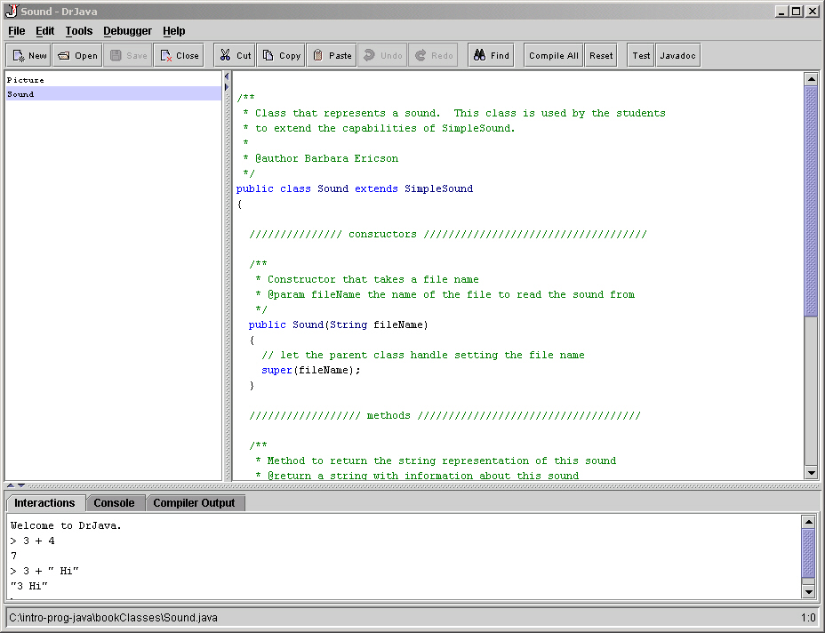
DrJava Features
Works with multiple files
  Files pane
Color coded editor
  Definitions pane
Interpretation of Java code
  Interactions pane
Integrated debugger
Files
pane
Interactions pane
Definitions pane

Slide 6
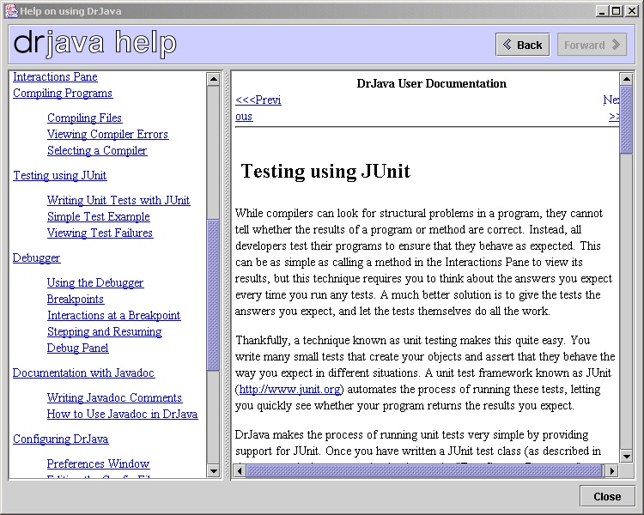
Help Window
Click on Help in the menu and then again on Help to bring up the help window
  Or use F1
The table of contents is on the left
  Click on a topic to see the help on the right

Slide 7
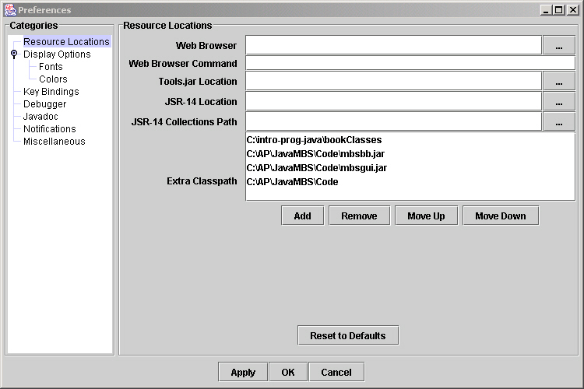
How to add to the classpath
Bring up the preferences window
  Click on Edit and then Preferences
  Click the add button
    And select all jar files that you want to add to the classpath
    Also add directories that have classes that you wish to add to the classpath
    When you are done click on “Ok”
Notes:
Clicking on “Apply” save the information but doesn’t exit the window. Clicking on “Ok” saves the information and closes the window.
The classpath is where the Java compiler and run-time will look for classes.

Slide 8
How to use the interactions pane
If you don’t end a statement with a semicolon ‘;’ it will be interpreted and the result printed
If you end a statement with a semicolon it will be interpreted but the result won’t be printed
  Use System.out.println(expression) to print
To enter multiple line statements use Shift + Enter

Slide 9
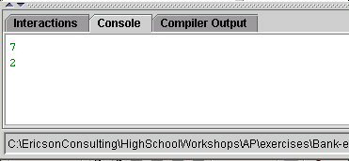
How to use the console pane
If you click on the console tab
  You will see the console pane
It shows just the items that you have printed to the console
  Using System.out.println or
  System.out.print

Slide 10
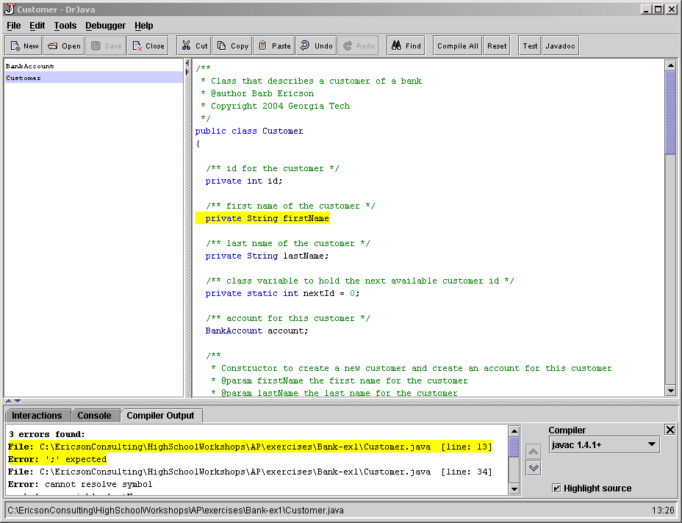
Compiler output pane
Compiler errors are shown in the compiler output pane
  The first error will be highlighted and the line of code that caused the problem will be highlighted
  You can also click on an error to go to the line that contains the error

Slide 11
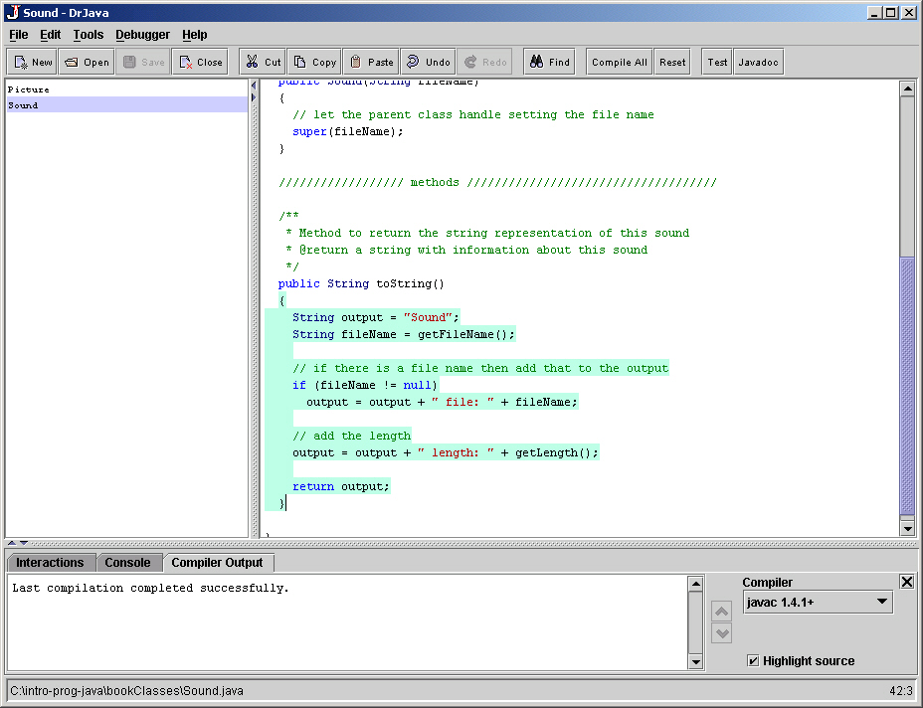
How to use the definitions pane
Click in the definitions pane to add code to a file
  It will automatically indent for you when you hit enter
    Or use tab
  It will highlight all code in a block when you click to the right of a closing parenthesis
  You can indent selected lines using the Edit menu
  You can comment out and uncomment lines in the Edit menu

Slide 12
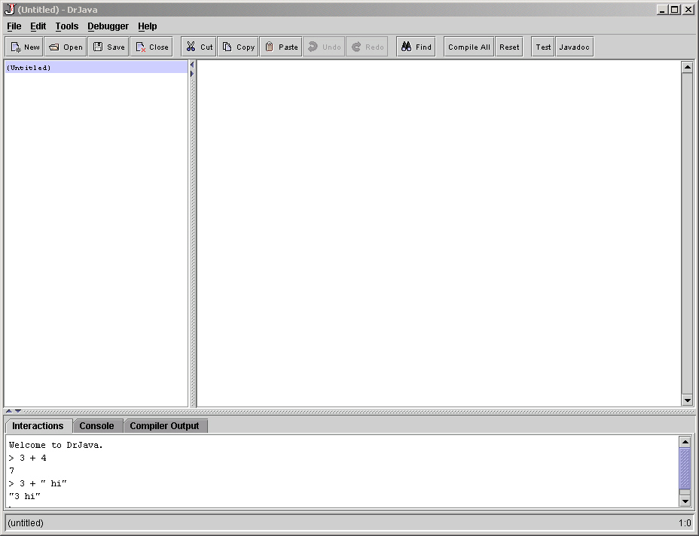
How to compile programs
Click on Compile All to compile all files in the files pane
  Or use Tools->Compile All Documents
You can compile just the shown file by using
  Tools->Compile Current Document
Click here to compile
all open files

Slide 13
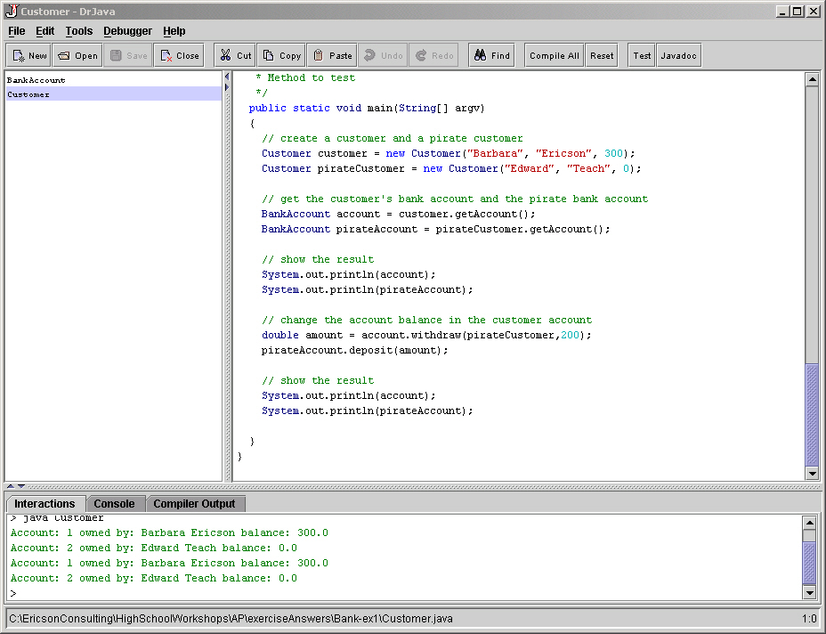
How to execute programs
Make sure that the file that you want to run the main method from is selected in the files pane
Click on Tools->Run Document’s Main Method
Output will be shown in the interactions and console panes

Slide 14
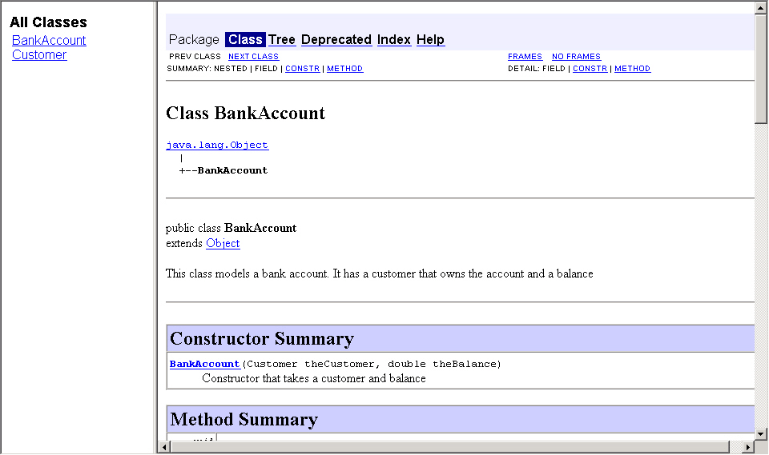
How to generate Javadoc documents
Click on the Javadoc button
  It will generate the Javadoc documentation for all files in the folder and all subfolders for all open files
  From javadoc comments
  /** comment */

Slide 15
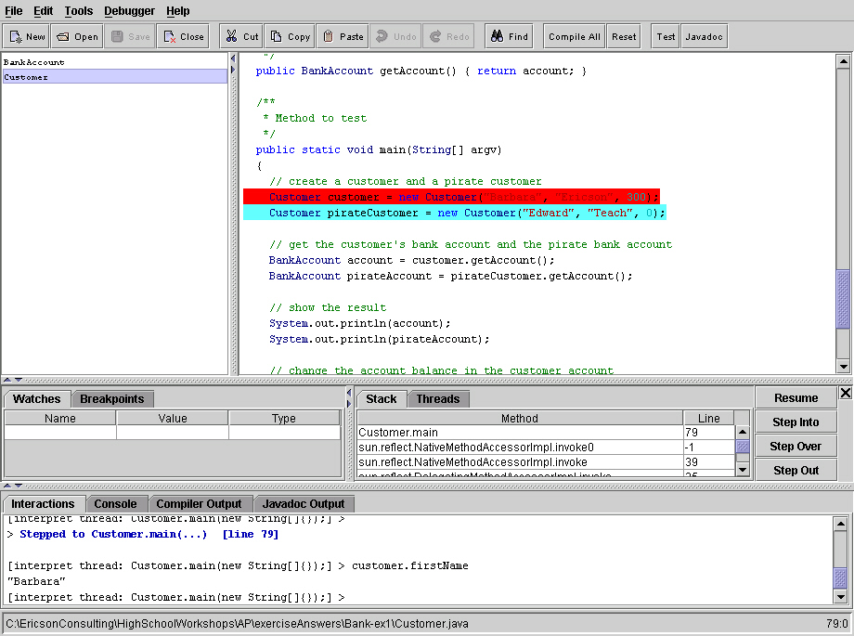
How to use the debugger
Click Debugger->Debug Mode
Select a line of code to stop at “breakpoint”
  Right click and Toggle Breakpoint
  You can have several breakpoints
Run the main method
Use the interactions pane to explore the variables

Slide 16
Debug Stepping and Resume
Use Step Into
  To see each piece of the current line being executed.
  Goes into methods
Use Step Over
  To execute the current line without seeing the execution and stop before the next line is executed
Use Step Out
  To execute the rest of the current method and stop before the next line in the calling method
Use Resume
  To continue execution still the next breakpoint or the end of the program
Stepping Options

Slide 17
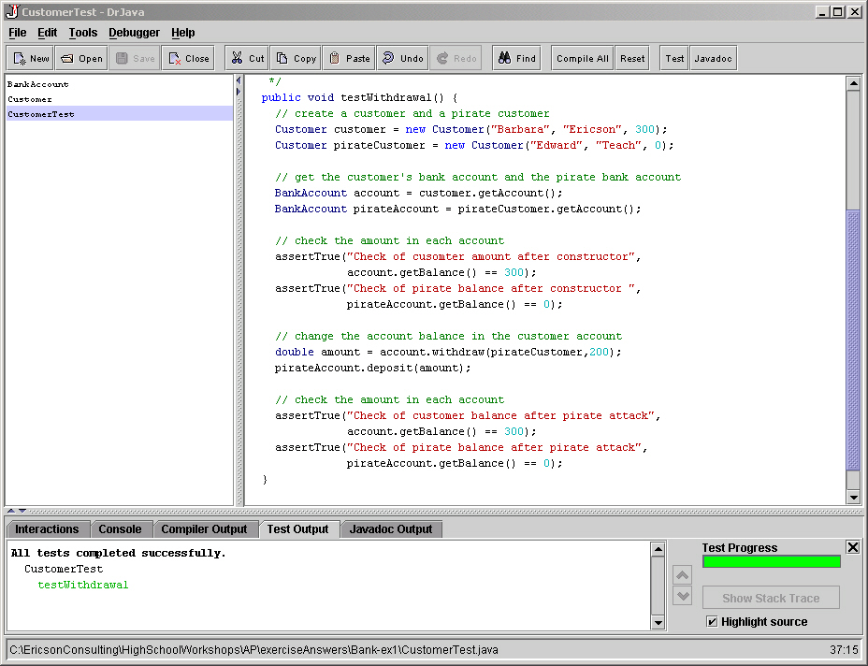
How to create JUnit tests
Click on “Edit” then "New JUnit Test Case"
Create one or more testSomething methods
  assertTrue(String,
  boolean)
  assertEquals(String,int,int)
  fail(String)
Notes:
See http://junit.sourceforge.net/doc/cookbook/cookbook.htm for more information on creating tests with JUnit.
Use assertTrue to check that the result of the boolean expression is true. If it fails the passed string will be printed.
Use assertEquals to check if the two passed int values are equal. If they are not it will print the string.
The fail(String) method will automatically fail and print the string.

Slide 18
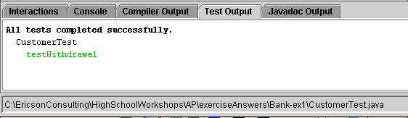
How to run JUnit tests
Click the Test button
  Results are shown in the Test Output pane
All failures will be reported
JUnit tests are very useful for initial testing
  And regression testing
Notes:
Regression testing is to make sure that things that used to work still work after a change.
In Extreme Programming you write the test cases first before you write the code. That way you will know when the code works.

Slide 19
Summary
DrJava is a free, lightweight, development environment
  Designed for students
You can use it to create, compile, debug and execute Java programs
You can use it to generate Javadoc documentation
You can use it to create and run JUnit tests

